Slide 1

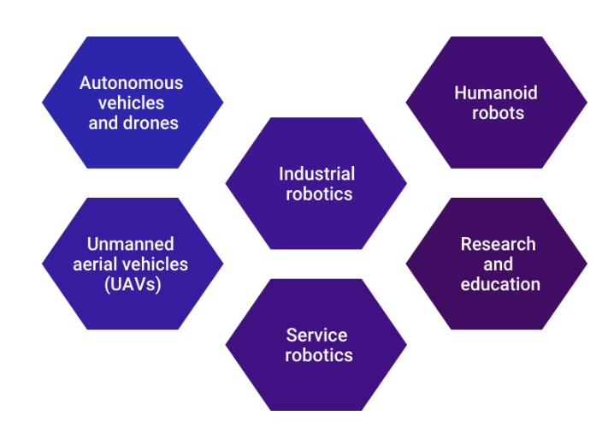
Objective
The aim of this project consists of designing an autonomous navigation system to drive a TurtleBot3 (TB3) robot in a Gazebo simulation environment. To sort off this task, ROS (Robot Operating System) is used for its wide field of applicability regarding robotics applications:

Slide 2
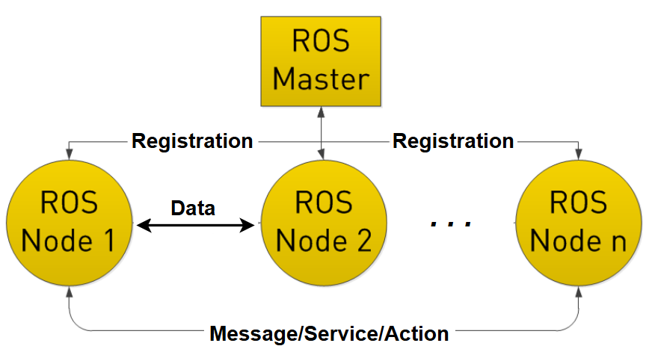
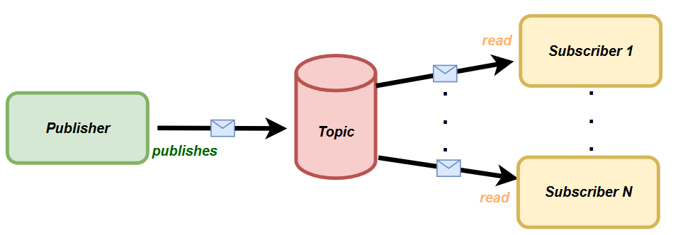
What is ROS?
ROS is a modular framework to develop distributed robotic applications. Its strength comes from the possibility to organize the task execution on a communication graph where each node accomplishes a specific assignment. Nodes can exchange information conveying data through the Master node.
There are several forms of communication which are:
ROS Message: a publisher sends messages through the communication link (topic). One or more subscribers can read the contents of the messages. The communication is asynchronous so that the publisher goes on publishing even if there are not subscribers connected.

Slide 3
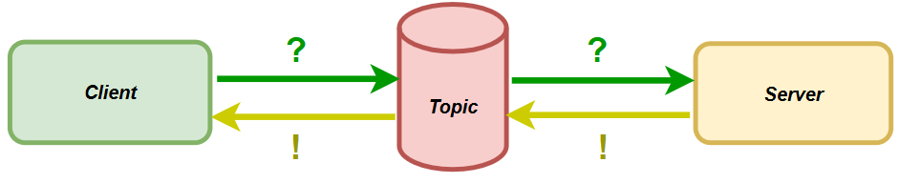
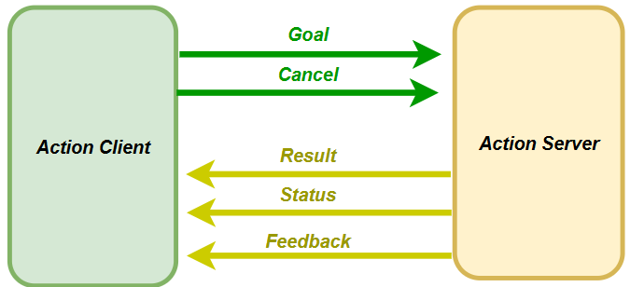
What is ROS?
ROS Service: a client requests a service from a server which elaborates the response. The communication is synchronous so that when the client asks for the service it stops its execution waiting for the response.
ROS Action: an action client sends a request to an action server. The communication is asynchronous that is the client can do other stuffs in the meanwhile the server is elaborating the response.
Goal: contains the information regarding the input for the request
Cancel: is sent to abort the request
Result: is the output sent from the server
Status: an informative message to describe the current state of the operation
Feedback: generated every once in a while to send information about the operation

Slide 4
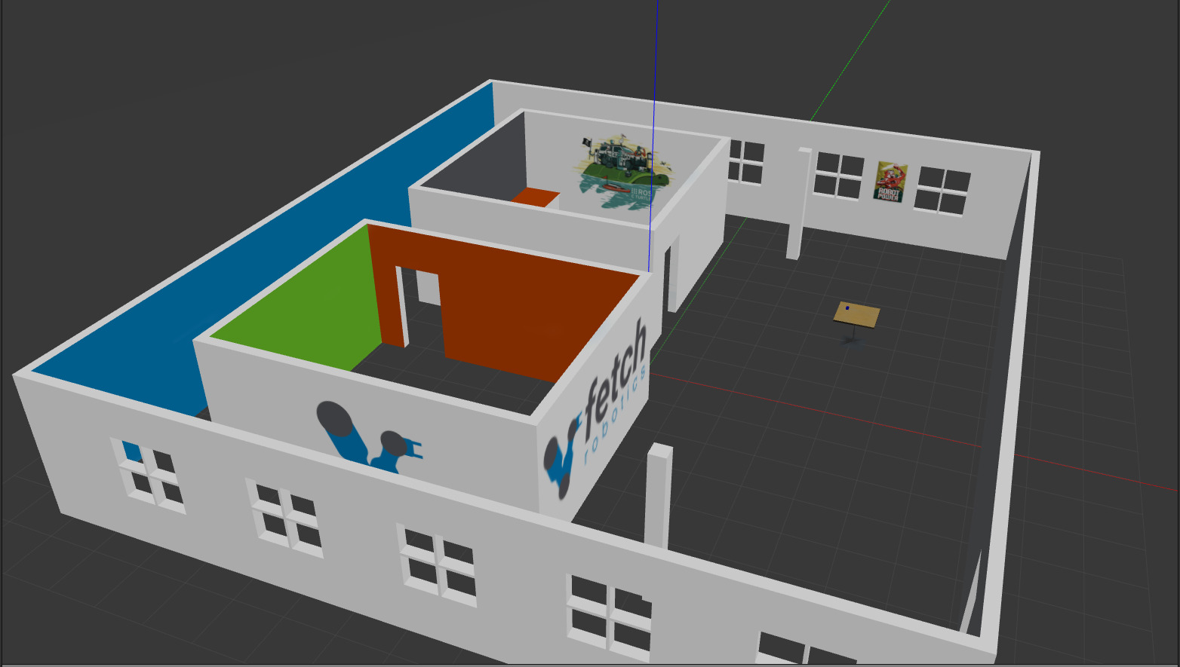
Project

Slide 5

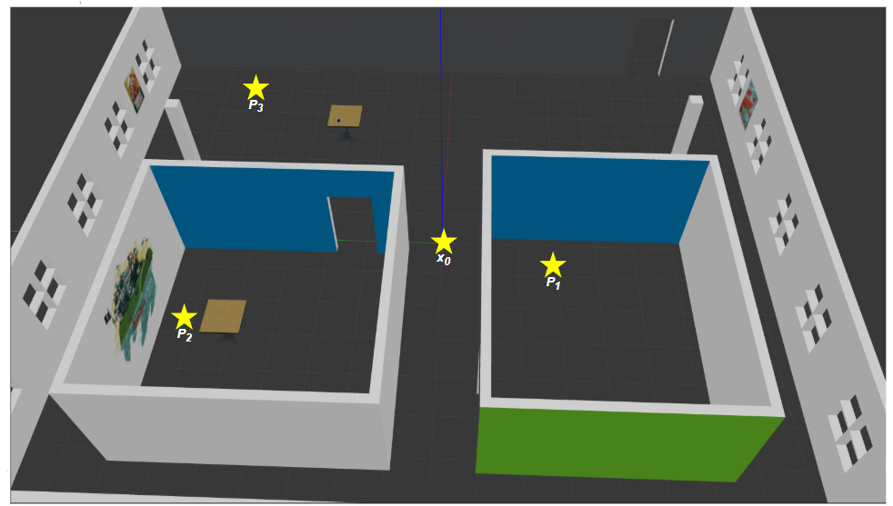
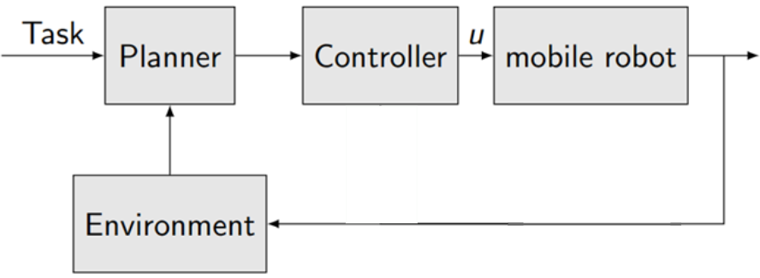
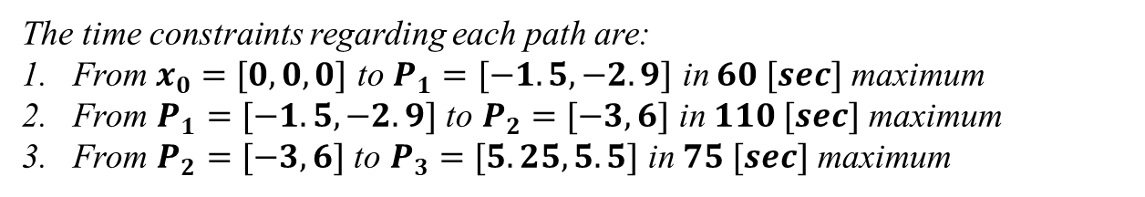
It is required to design a navigation system for a Turtlebot robot in presence of static obstacles. The robot must pass over three objective points starting from an initial condition
The time constraints regarding each path are:
From $x_{0}=[0,0,0]$ to $P_{1}=[−1.5, −2.9]$ in $60 [sec]$ maximum
From $P_{1}=[−1.5, −2.9]$ to $P_{2}=[−3, 6]$ in $110 [sec]$ maximum
From $P_{2}=[−3, 6]$ to $P_{3}=[5.25, 5.5]$ in $75 [sec]$ maximum
To approach the problem, we resort the classical control loop for robotic applications. Each block is responsible for implementing a specific operation to make the robot able to complete the task.

Slide 6
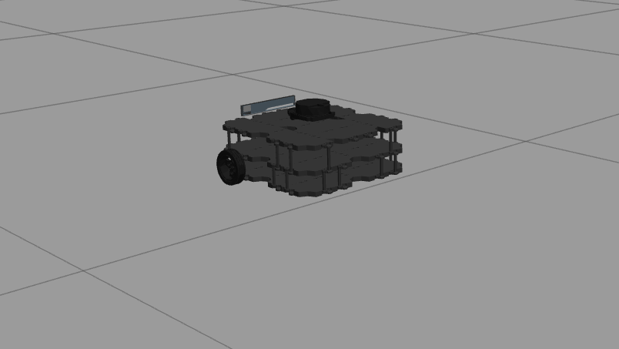
Robot Model

Slide 7
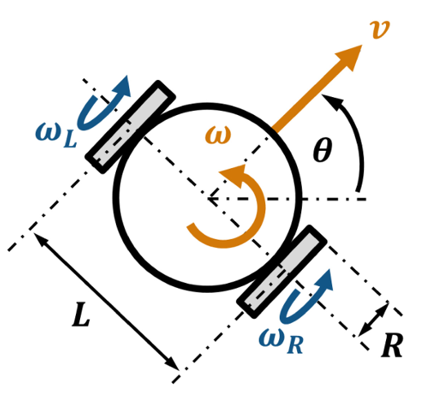



Robot Model
The robot is a TurtleBot3 waffle, already implemented in the Ros libraries. Its dynamics is described by a differential drive model:
FORWARD KINEAMATICS
Given the input of the model compute the output:
$\left\{\begin{aligned}v=\frac{R}{2}∗(w_{r}+w_{l}) \\ w=\frac{R}{L}∗(w_{r}−w_{l}) \end{aligned}\right.$
INVERSE KINEAMATICS
Given the output of the model compute the input:
$$\left\{\begin{aligned}w_{l}=\frac{1}{R}∗(v−\frac{wL}{2}) \\ w_{r}=\frac{1}{R}∗(v+\frac{wL}{2}) \end{aligned} \right.$$
Since $w_{l}$ and $w_{r}$ can be different, the robot is able to steer following circular trajectories. Moreover, if one of them is zero, it can rotate without moving (linear speed v equal to zero).
Ros makes the life of the designer easier since to control the robot it is required to design just the linear and angular speed (like in a unicycle model). Starting from the knowledge of both of them, the robot will move according to the equations of the inverse kinematics

Slide 8
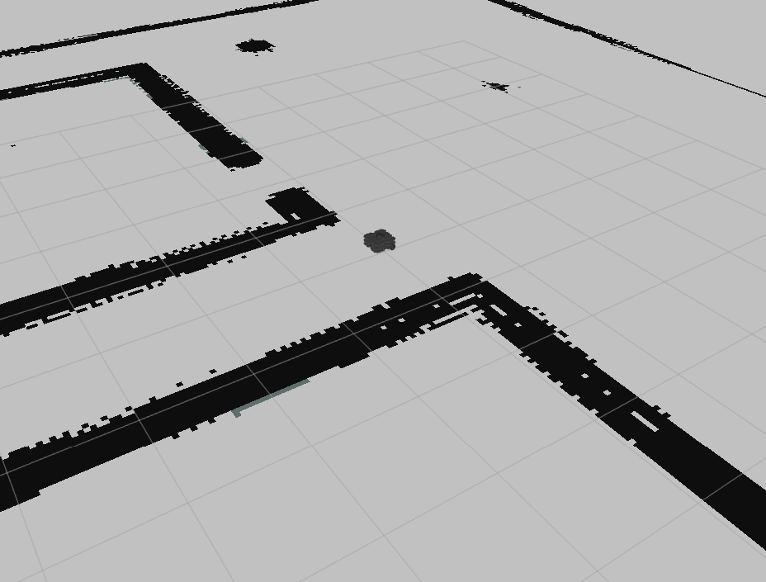
Map

Slide 9
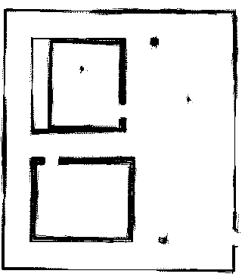
Map
The map of the environment is known a-priori and described by the following figure
From it, it is possible to define a global costmap that is the representation of the environment useful during the planning phase. Indeed, the planner should work on a safe map in order to avoid unexpected collisions with obstacles. This can include enlargement operation on the obstacles and filling of empty areas of the map where obstacles can reside. These procedures will be crucial for the planning strategy chosen, as we will see

Slide 10
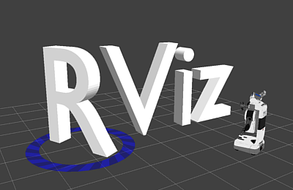
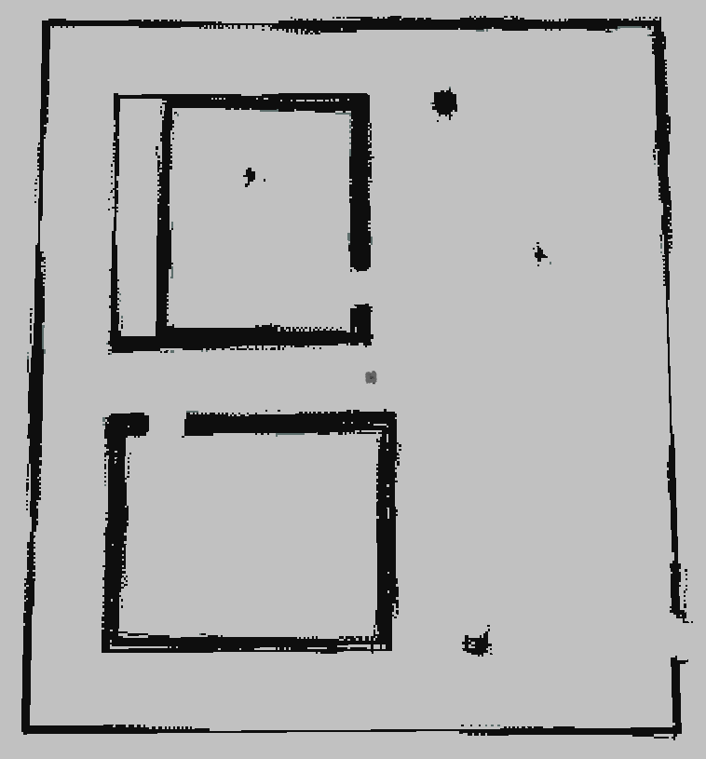
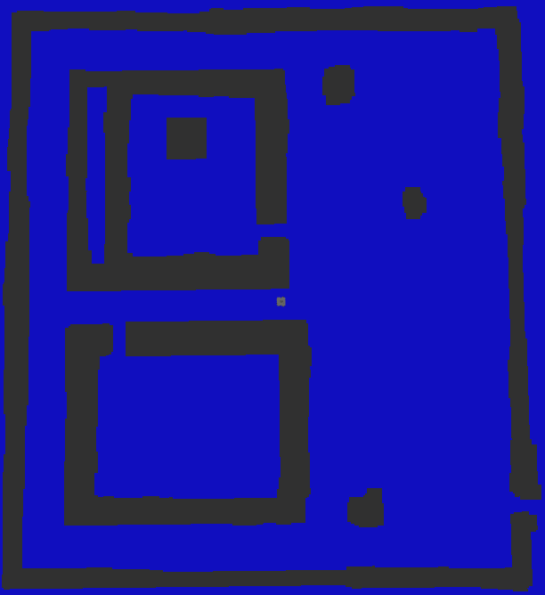
Map
Starting from the knowledge of the a-priori map, after the operations, we end up with the global costmap
a-priori map
Global costmap
In this way, there is ensurance that the robot will maintain a safe distance from the perimeter of both obstacles and walls. In addition, since the map comes from a mapping operation performed by lidar detection, possible obstacles not well defined in their shape during the mapping are now considered

Slide 11

Project Architecture
The project is organized in four python classes, each one with specific assignments, here reported:
Scheduler: is responsible for sending the next point to reach (between $P_{1}$, $P_{2}$ and $P_{3}$) to enable the planning phase
Global Planner: after receiving the goal to reach, computes the path to ensure the robot arrives to the target point avoiding obstacles in its route. When the path is available, it sends the whole trajectory to the local planner
Local Planner: from the path computed in the planning phase, selects the current waypoint to send to the controller in order to make the robot able to reach all the target points of the trajectory. Moreover it sends further information regarding the linear and angular reference speeds to be tracked
Controller: when a new target point is received, it computes the linear and angular speeds to move the robot until the euclidean distance between the robot pose and the target point is lower than a specific threshold value. It repeats the operation for all the points of the trajectory

Slide 12
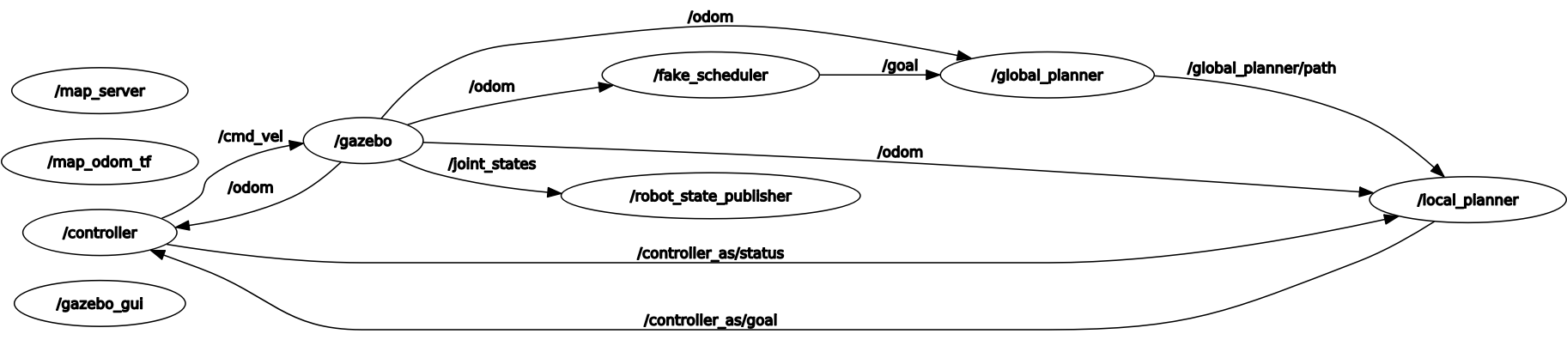
Project Architecture: How do nodes communicate?
As we can imagine, each class represents a Ros node in the system. The whole exchange of information can be summed up as follows
/scheduler
Beyond the nodes named so far, it is possible to notice the presence of the node associated to Gazebo. This one plays a crucial role in the implementation of the physics during the execution. Let’s see more in details how the exchange of information is implemented

Slide 13

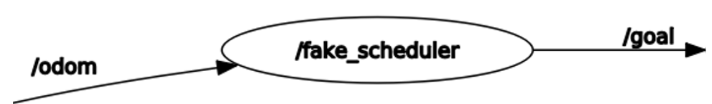
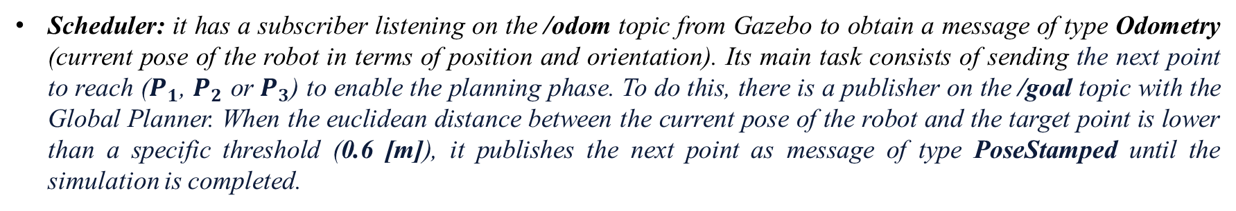
Project Architecture: How does scheduler communicate?
/scheduler
/scheduler
Scheduler: it has a subscriber listening on the /odom topic from Gazebo to obtain a message of type Odometry (current pose of the robot in terms of position and orientation). Its main task consists of sending the next point to reach ($P_{1}$, $P_{2}$ or $P_{3}$) to enable the planning phase. To do this, there is a publisher on the /goal topic with the Global Planner. When the euclidean distance between the current pose of the robot and the target point is lower than a specific threshold (0.6 [m]), it publishes the next point as message of type PoseStamped until the simulation is completed.

Slide 14
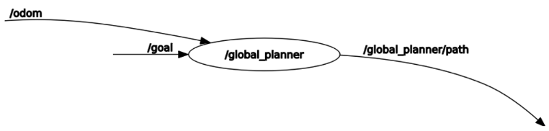
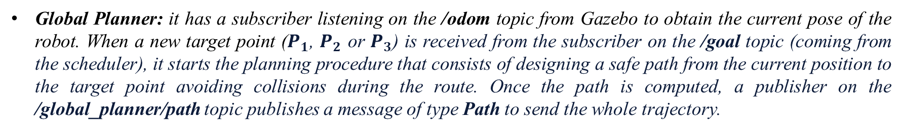
Project Architecture: How does Global Planner communicate?
/scheduler
Global Planner: it has a subscriber listening on the /odom topic from Gazebo to obtain the current pose of the robot. When a new target point ($P_{1}$, $P_{2}$ or $P_{3}$) is received from the subscriber on the /goal topic (coming from the scheduler), it starts the planning procedure that consists of designing a safe path from the current position to the target point avoiding collisions during the route. Once the path is computed, a publisher on the /global_planner/path topic publishes a message of type Path to send the whole trajectory.

Slide 15
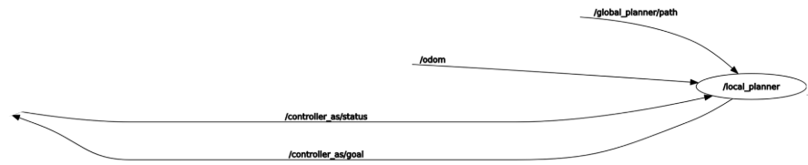
Project Architecture: How does Local Planner communicate?
/scheduler
Local Planner: it is listening on the /odom topic from Gazebo. A subscriber on the /global_planner/path topic receives the trajectory from the Global Planner. When the path is available, it computes the reference speeds in terms of linear and angular based on the trajectory and the sampling time (0.5 [sec]). Its role consists of selecting the current waypoint to send to the controller in order to make the robot able to reach all the target points of the trajectory. To do this, there is an action client connected with the Controller. When the controller succeded to reach the current point on the trajectory, the Local Planner receives the result and sends the next goal until the euclidean distance between the current pose and the last point of the route becomes lower than 0.2[m]. Once it happened, the trajectory tracking for the current path can be considered completed.

Slide 16
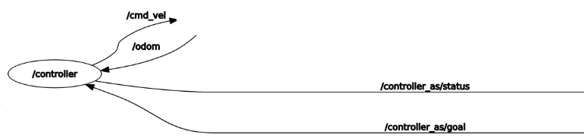
Project Architecture: How does Controller communicate?
/scheduler
Controller: it is listening on the /odom topic from Gazebo. An action server is ready to receive the goal from the action client implemented in the Local Planner. When the goal arrives, it computes the linear and angular speeds according to the control law and, by a Twist message, publishes them on the /cmd_vel topic. At each iteration the euclidean distance between the robot position and the goal is updated and sent as feedback to the Local Planner. The control action goes on until the distance becomes lower than 0.2 [m]

Slide 17
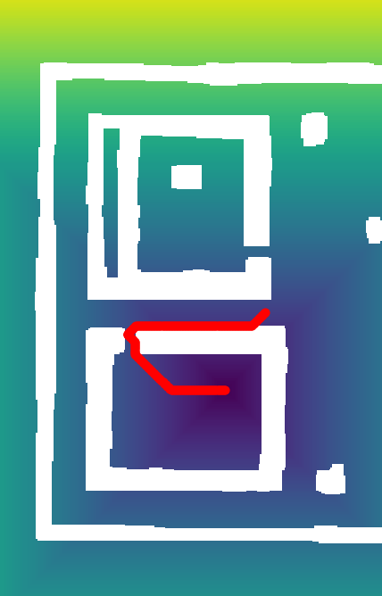
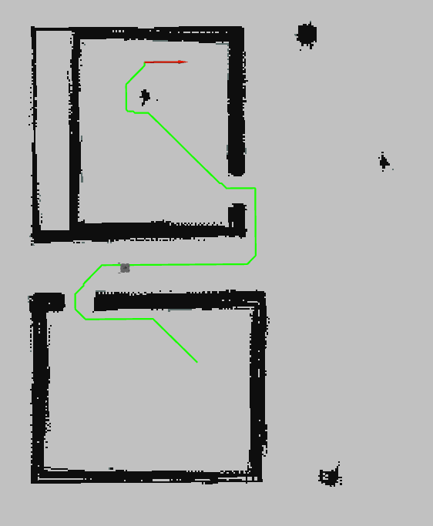
Planner

Slide 18
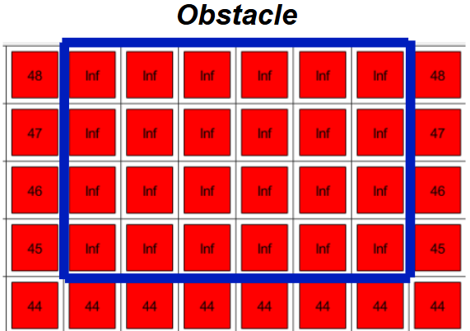
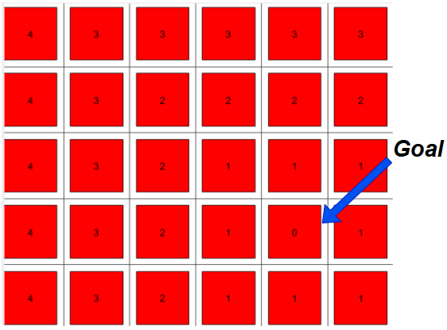
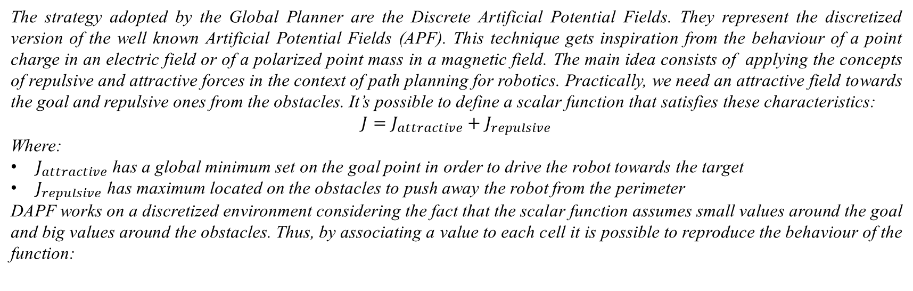
Discrete Artificial Potential Fields (DAPF)
The strategy adopted by the Global Planner are the Discrete Artificial Potential Fields. They represent the discretized version of the well known Artificial Potential Fields (APF). This technique gets inspiration from the behaviour of a point charge in an electric field or of a polarized point mass in a magnetic field. The main idea consists of applying the concepts of repulsive and attractive forces in the context of path planning for robotics. Practically, we need an attractive field towards the goal and repulsive ones from the obstacles. It’s possible to define a scalar function that satisfies these characteristics:
$$J=J_{attractive}+J_{repulsive}$$
Where:
$J_{attractive}$ has a global minimum set on the goal point in order to drive the robot towards the target
$J_{repulsive}$ has maximum located on the obstacles to push away the robot from the perimeter
DAPF works on a discretized environment considering the fact that the scalar function assumes small values around the goal and big values around the obstacles. Thus, by associating a value to each cell it is possible to reproduce the behaviour of the function:

Slide 19
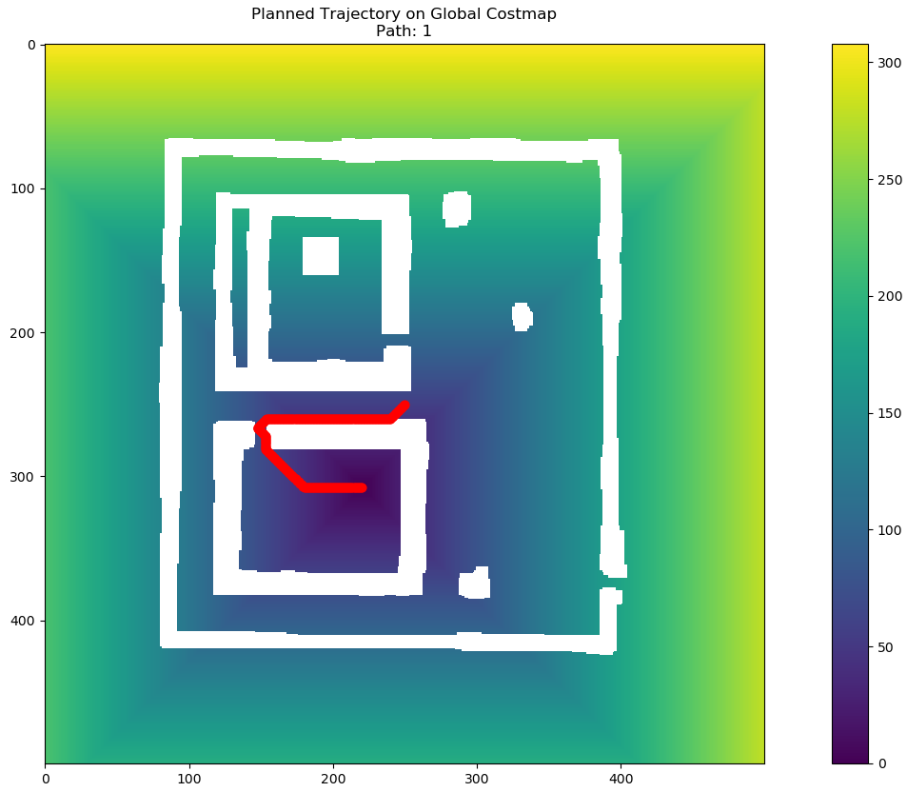
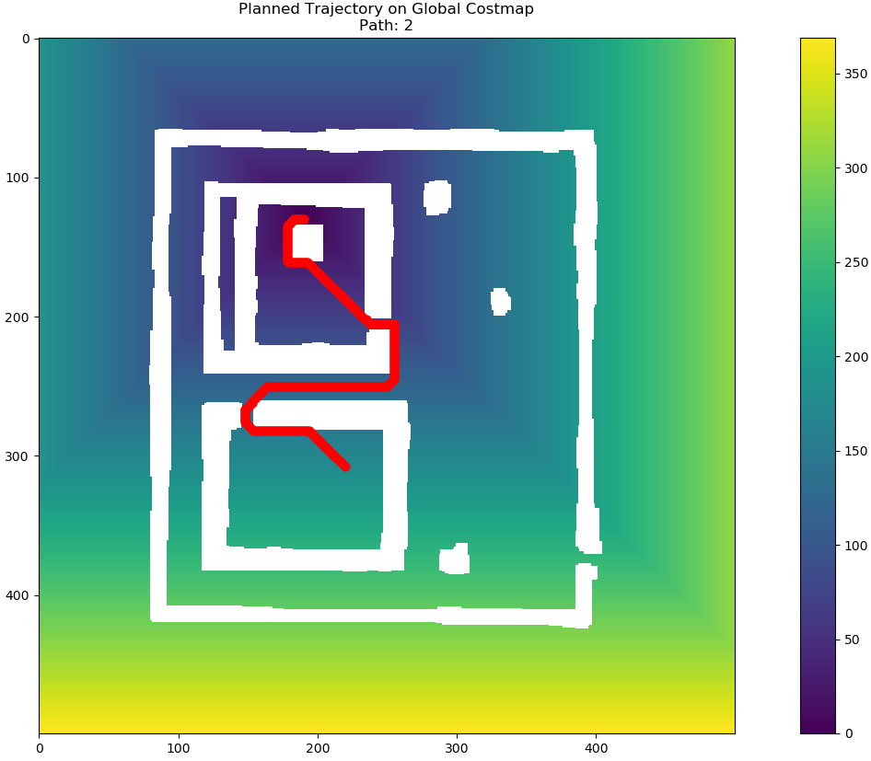
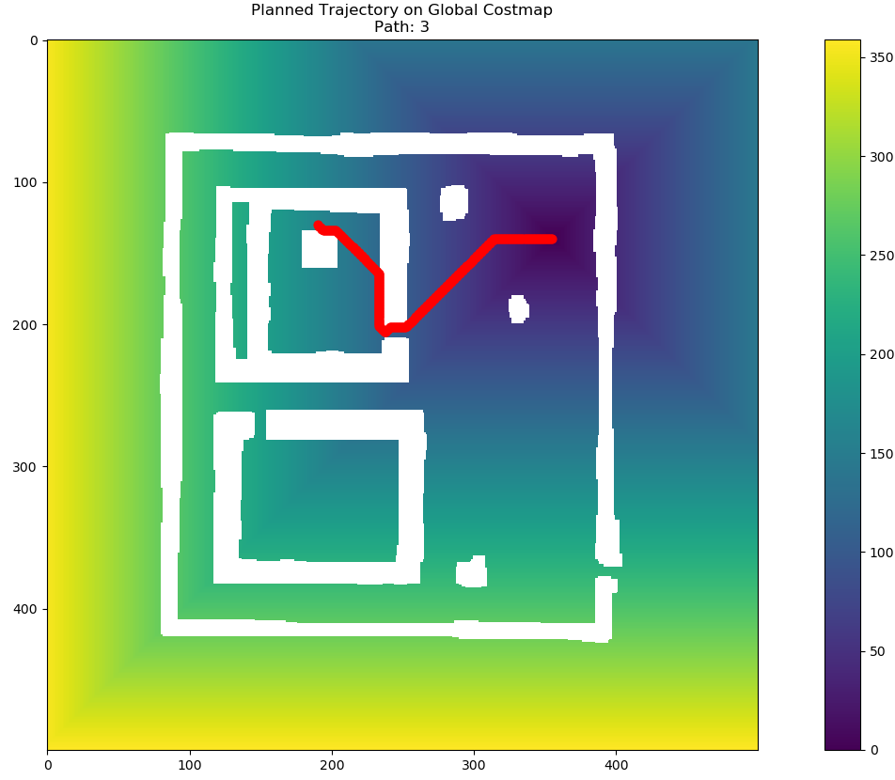


Discrete Artificial Potential Fields (DAPF)
The logic of the algorithm is the following:
Define the grid map using the potential values
At each iteration: consider the 8 neighbours (adjacent cell) and move to the neighbour with the smallest value. If multiple cells share the same optimal value, select the cell with the minimum euclidean distance from the goal.
Iterate until the cell containing the goal is reached
The strength of this technique consists of generating paths which have linear trajectories, this aspect can be useful to reduce the execution time. The limits are related to the possibility to face with local minima and with near passage to the obstacles. To sort off possible local minima, some sub-goals have been considered
Let’s have a look at the results of the planning phase:
Path from $x_{0}$ to $P_{1}$
Path from $P_{1}$ to $P_{2}$
Path from $P_{2}$ to $P_{3}$

Slide 20
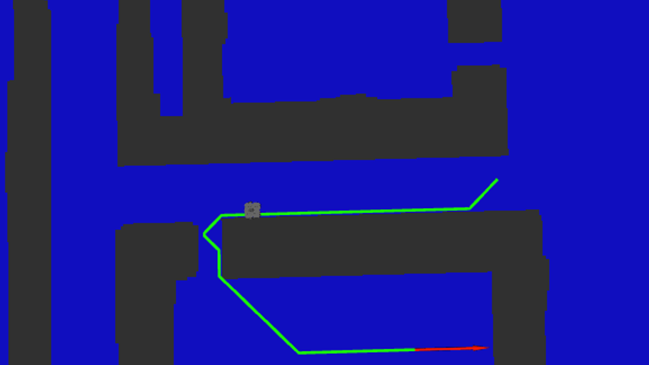
Controller

Slide 21

Control Law
The controller is responsible for generating the control inputs (linear and angular speeds) to make the robot capable to track the trajectory. Input commands are computed according to the following law:
$$\left\{\begin{aligned}v=v^{∗}\cos\left(e_{θ}\right)+k_{1}(v^{∗},ω^{∗})e_{x} \\ ω=ω^{∗}+k_{2}v^{∗}\frac{sin⁡\left(e_{θ}\right)}{e_{θ}}e_{y}+k_{3}(v^{∗},ω^{∗})e_{θ}\end{aligned}\right.$$
Where:
$v^{∗}$, $ω^{∗}$ are the reference speeds computed as follows:
$$v^{∗}\left(k\right)=\sqrt{{(\frac{x^{∗}\left(k\right)−x^{∗}\left(k−1\right)}{T_{s}})}^{2}+{(\frac{y^{∗}\left(k\right)−y^{∗}\left(k−1\right)}{T_{s}})}^{2}}$$
$$ω^{∗}\left(k\right)=arctg2⁡(\sin\left(\frac{θ^{∗}\left(k\right)−θ^{∗}\left(k−1\right)}{T_{s}}\right),\cos\left(\frac{θ^{∗}\left(k\right)−θ^{∗}\left(k−1\right)}{T_{s}}\right))$$
With:
$x^{∗},y^{∗}$, $θ^{∗}$ reference positions and angle
$k_{1}\left(v^{∗},ω^{∗}\right)>0$, $k_{3}\left(v^{∗},ω^{∗}\right)>0$ both bounded with bounded derivative
$k_{2}>0$
$ex=\cos\left(θ\right)∗\left(x^{∗}−x\right)+\sin{(θ)}∗\left(y^{∗}−y\right)$
$ey=−sin\left(θ\right)∗\left(x^{∗}−x\right)+\cos{(θ)}∗\left(y^{∗}−y\right)$
$e_{θ}=arctg2(\sin\left(θ^{∗}−θ\right),cos⁡\left(θ^{∗}−θ\right)$)
Errors expressed in the robot reference frame

Slide 22
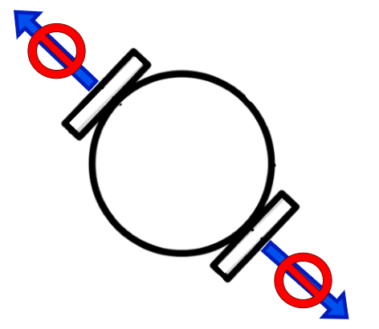
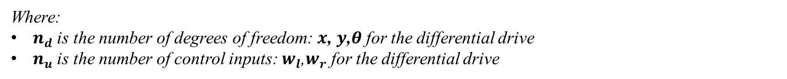


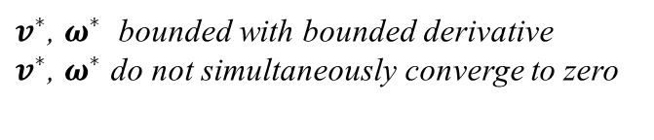
Control Law
The control law is non linear for the presence of trigonometric functions and rational terms. The main advantage of choosig this controller is the following result:
$v^{∗}$, $ω^{∗}$ bounded with bounded derivative
$v^{∗}$, $ω^{∗}$ do not simultaneously converge to zero
$$\lim_{t→∞}{e\left(t\right)=0}$$
Thus, the law ensures asymptotic convergence on the trajectory even if the robot model is non-holonomous. About the non-holonomicity property, it holds:
$$n_{d}>n_{u}$$
the model is non-holonomic
Where:
$n_{d}$ is the number of degrees of freedom: $x$, $y$,$θ$ for the differential drive
$n_{u}$ is the number of control inputs: $w_{l}$,$w_{r}$ for the differential drive
So, the robot model has non-holonomic constraints which are related to the impossibility of moving sideways

Slide 23
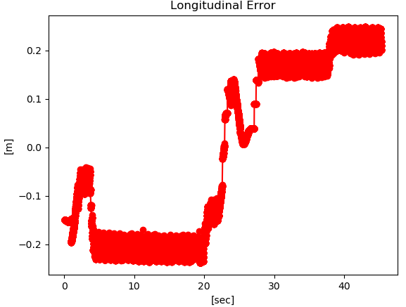
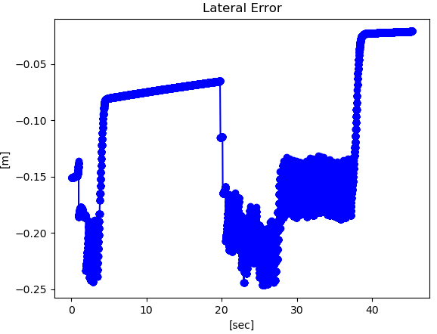
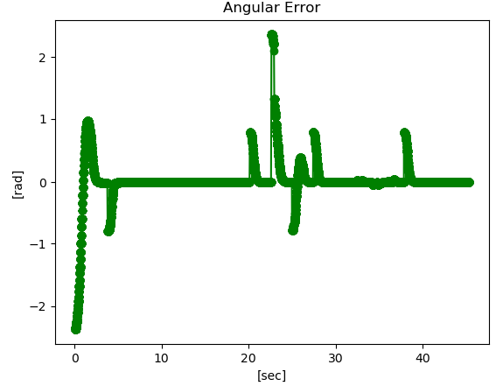
Simulation Results: Tracking Errors
Let’s have a look at the tracking error, that is the displacement between the desired trajectory and the pose of the robot assumed during the three paths:
Path 1
Error along x axis
Error along y axis
Angular Error

Slide 24
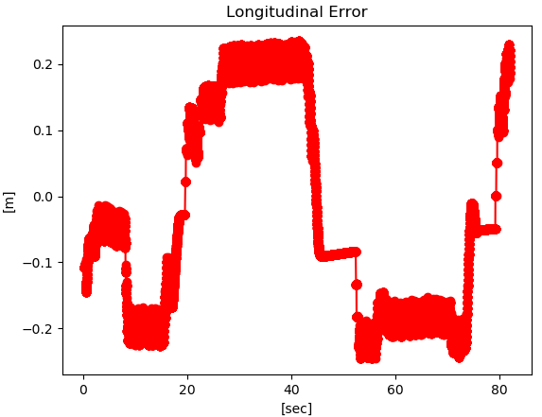
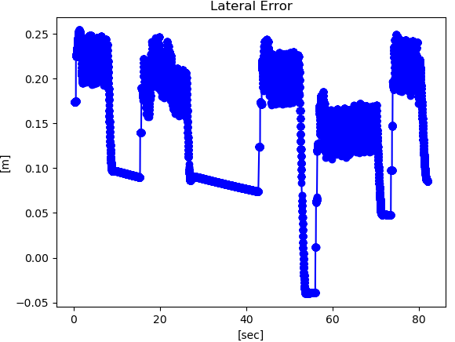
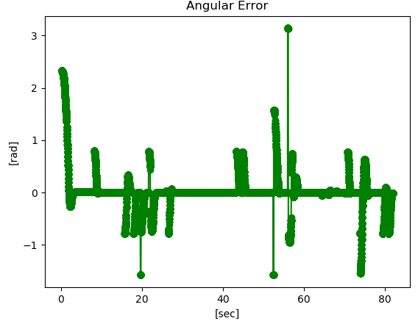
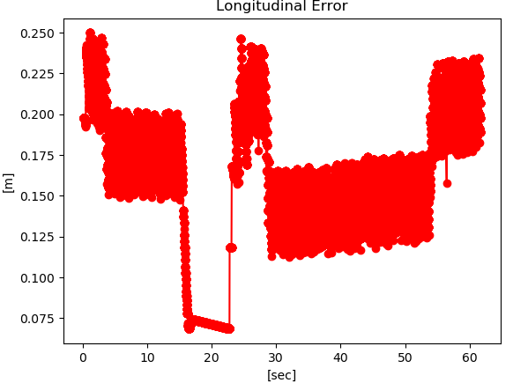
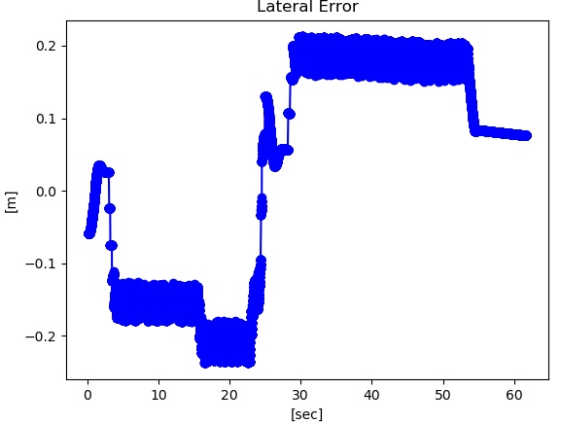
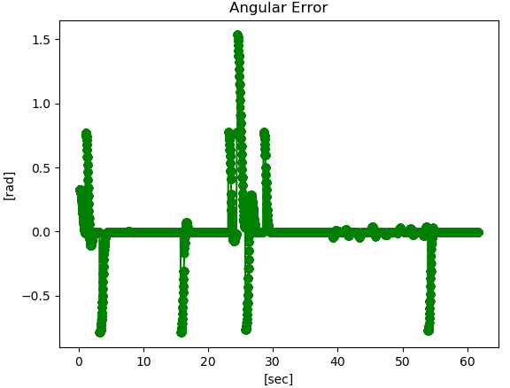
Simulation Results: Tracking Errors
Path 2
Error along x axis
Error along y axis
Angular Error
Path 3
Error along x axis
Error along y axis
Angular Error

Slide 25
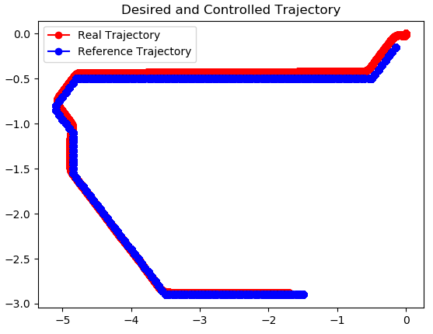
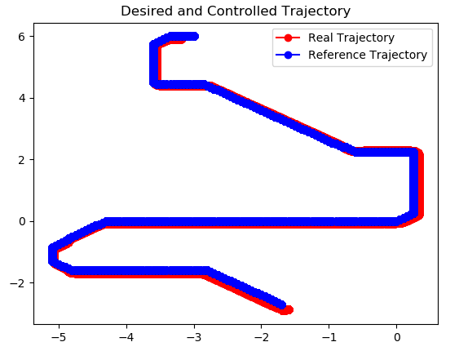

Simulation Results
Simulation Results: Trajectory Comparison
From the previous figures it is possible to verify that the tracking error along the axes oscillates in a range of [-0.25[m] 0.25[m]]. This result is coherent with the threshold used in the control law, that is 0.2 [m]. For what concerns the orientation, the robot is capable to devotedly track the angular reference during the linear path. Some differences arise during the non linear parts of the route, as expected.
The figures below show the comparison between the reference trajectory designed by the Global Planner and the real trajectory implemented by the Controller:
Path 1
Path 2
Path 3

Slide 26
Simulation Results
Simulation Results: Execution Time
About the simulation time, there are constraints regarding the execution. The following table illustrates the execution time for each path and the corresponding time constraint:
Path | 1 | 2 | 3
Time Constraint | 60 [sec] | 110 [sec] | 75 [sec]
Execution Time | 45.37 [sec] | 82.11 [sec] | 61.76 [sec]
It is possible to notice that all the paths have satisfied the constraints.

Slide 27
Thank You for your attention

